Slide 1
Paul and Virginia Engler College of Business
West Texas A&M University
Employee Fraud Detection System
Capstone project
By: Farzaneh Noroozi
Spring Semester 2024

Slide 2
Introduction:
Employee fraud presents a significant threat to organizations globally, resulting in financial losses, damaged reputation, and compromised integrity. Detecting and preventing such fraudulent activities is crucial for organizational security and trust. To address this challenge, the project proposes the development of an Employee Fraud Detection System. This system leverages advanced data analytics, data mining techniques, robust system development methodologies, and cybersecurity measures to identify suspicious activities and potential fraud instances within the organization.

Slide 3
Project Description:
The project aims to create an employee fraud detection system using knowledge acquired from the following categories:
Networking and Cybersecurity (CIDM 6356 & CIDM 6340)
Data Analytics (CIDM 5310)
Data Management (CIDM 6350 & CIDM 6355)
System Development (CIDM 6303)
The system will analyze employee behavioral data, financial transactions, and access logs to identify suspicious activities and potential fraud within the organization.

Slide 4
Data Collection and Integration:
The idea for the system was inspired by CIDS 6356, focusing on fraud detection in a company. Synthetic data will be generated to simulate financial transactions, access control systems, and HR databases. The process involves generating fake employee data and transaction records.
Employee Data Generation:
A script using the faker library was provided to generate synthetic employee data.
Data includes EmployeeID, Name, HireDate, Street, City, and State.
23 employees' data was generated and exported to 'employee.csv'.
Transaction Data Generation:
Another script was provided to create synthetic transaction data with potential fraud.
Fields include ReturnId, IsReceiptPresent, ReceiptId, ReturnDate, ReturnPrice, CustomerName, Street, City, State, CustomerPhone, CreditCardNum, CreditCardExpire, GiftCardNumber, EmployeeId, CustomerID.
Fraud is introduced by modifying fields such as IsReceiptPresent, ReturnPrice, and CreditCardNum.
Here is the link to the code for making fake data.
Since each time the result would be different Please find the database here.

Slide 5
Data Management
Data Management Challenges:
Organizations struggle with managing and analyzing diverse data sources like employee activity logs, financial transactions, access control systems, and HR databases. The complexity and volume of this data pose difficulties in collection, integration, preprocessing, and analysis.
Motivation for Database Solution:
The database solution is driven by the need for organizations to proactively detect and prevent employee fraud. Traditional methods, relying on manual processes and rule-based systems, may not adapt well to evolving fraud schemes. The proposed solution utilizes advanced data analytics, machine learning algorithms, and robust system architectures for scalable and proactive fraud detection.

Slide 6
Potential Benefits:
Early Detection: Identifying suspicious activities early allows for intervention before significant losses.
Actionable Insights: Data analytics extracts patterns of fraudulent behavior, aiding informed decision-making.
Enhanced Security: Robust networking and cybersecurity measures ensure secure data transmission and storage.
Operational Efficiency: User-friendly interfaces streamline detection and investigation, improving efficiency and reducing response times.
Potential Users:
The Employee Fraud Detection System caters to various users within organizations:
Risk Management Professionals: Detect and prevent fraud risks proactively.
Financial Analysts: Analyze transactions to assess fraud risks.
Compliance Officers: Monitor employee behavior for compliance violations.
Executive Leadership: Gain strategic insights into fraud risks.

Slide 7
Forensic Objectives:
Audit for Potential Fraud in Customer Returns: Identifying fraudulent activities.
Audit for Improper Procedure Violations in Customer Returns: Detecting instances where employees deviate from company policies.
Business Rules for Customer Returns:
Customers can receive refunds to their debit/credit card or a gift card.
Employees must manually record customer details for all returns.
If a receipt is present, the system automatically records return date and price.
Refund options:
Gift Card: Employee scans the card, and the system adds the return price.
Debit/Credit Card: Employee swipes the card, and the system transfers the return price.
Without a receipt:
Gift Card: Issued for store credit, no debit/credit card refund.
Employee scans UPC barcode, system records price and date.
System adds return price to the gift card.

Slide 8
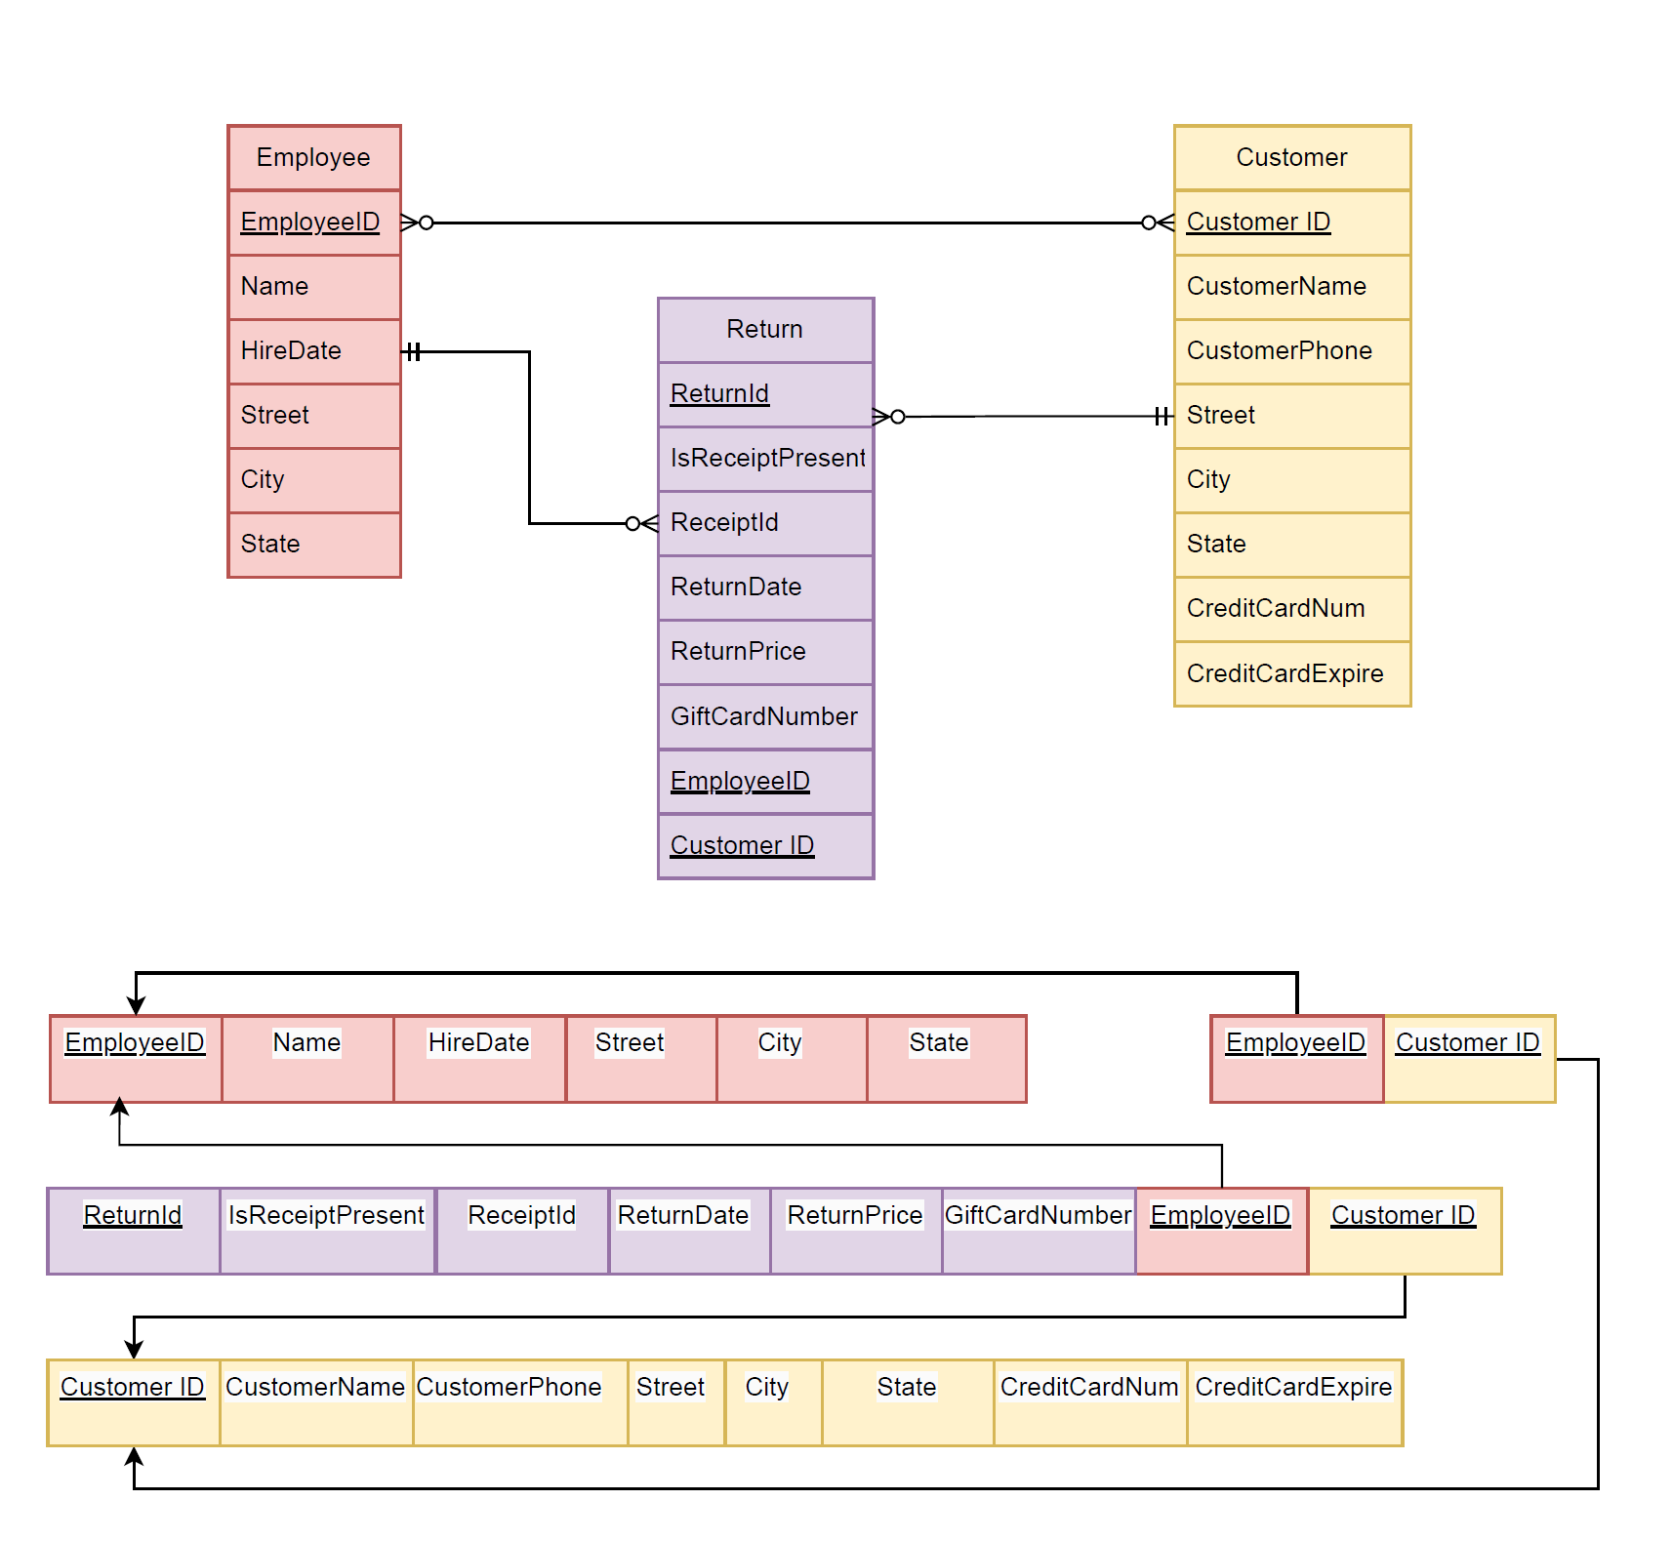
Enhanced Entity-Relationship Diagram (EERD)

Slide 9
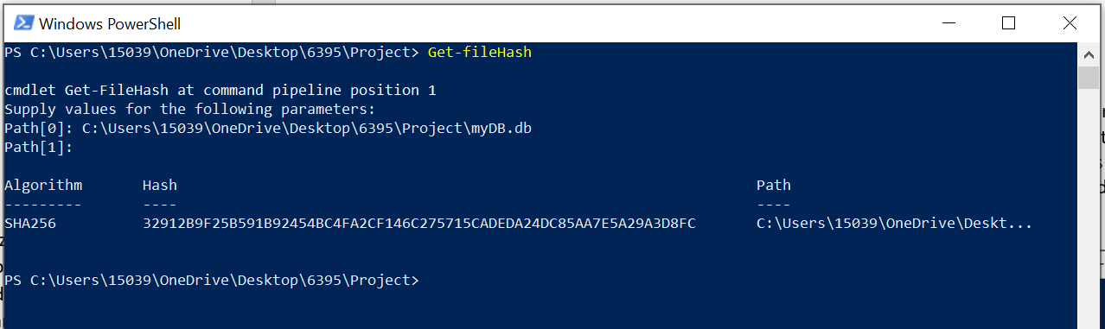
Data Analytics
The integrity of the database file, myDB.db, was verified using the SHA256 hash algorithm. The calculated hash is 32912B9F25B591B92454BC4FA2CF146C275715CADEDA24DC85AA7E5A29A3D8FC.

Slide 10
Returns Processed without a Receipt:
The analysis reveals employees who processed returns without a receipt:
Average: The average number of returns processed without a receipt is 29.04.
Standard Deviation: The standard deviation is 8.33, indicating variability across employees.
Outliers: Employees significantly deviating from the average by more than one standard deviation:
Steven Curtis (EmployeeID: 79023) processed 46 returns.
George Stevens (EmployeeID: 52272) processed 40 returns.
Angela Diaz (EmployeeID: 29733) processed 38 returns.
Dr. Thomas Weiss PhD (EmployeeID: 27935) processed 36 returns.
Chad Dawson (EmployeeID: 61373) processed 35 returns.
These individuals exhibit a notably higher-than-average volume of returns without a receipt. Further investigation is recommended to understand reasons behind this and ensure compliance with company return policies.
Num | EmployeeID | EmployeeName | NumReturns
1 | 79023 | Steven Curtis | 46
2 | 52272 | George Stevens | 40
3 | 29733 | Angela Diaz | 38
4 | 27935 | Dr. Thomas Weiss PhD | 36
5 | 61373 | Chad Dawson | 35
6 | 81344 | Seth Mckinney | 35
7 | 41845 | Samuel Obrien | 33
8 | 92530 | Jessica Short | 33
9 | 71186 | Katherine Brown | 32
10 | 54061 | Harry Chen | 31
11 | 40295 | Anthony Brown | 29
12 | 57258 | Jonathan Fowler | 29
13 | 80899 | Timothy Weber | 29
14 | 84966 | Judy Garcia | 29
15 | 97986 | David Mullen | 29
16 | 60657 | Amanda Anderson | 28
17 | 19694 | Andrew Owens | 26
18 | 69674 | Kristopher Mendez | 25
19 | 84034 | Susan Adkins | 25
20 | 26122 | Lindsey Maxwell | 24
21 | 26093 | Melissa Garcia | 20
22 | 28960 | Kaitlyn Matthews | 19
23 | 94877 | Kyle Brown | 15
If you're interested in discovering all the query codes within the SQLite file on GitHub, you can do so by following this link

Slide 11
Returns with Debit/Credit Card Refund and No Original Receipt:
The analysis focuses on returns processed by each employee where credit/debit cards were used for refunds without original receipts:
Steven Curtis leads with 46 returns.
George Stevens follows closely with 40 returns.
Angela Diaz processed 38 returns.
Analysis:
The distribution indicates varying levels of adherence to return policies regarding original receipts. Further investigation is recommended to understand why original receipts were missing in these transactions. Suggestions for improvement include:
Training Sessions: Regular training to reinforce the importance of verifying receipts.
System Improvements: Enhancements to the system to prompt employees to verify receipts before processing returns.
These measures aim to ensure compliance and minimize potential errors or fraud in return processing procedures.
EmployeeID | EmployeeName | NumReturnsWithoutReceipt
79023 | Steven Curtis | 46
52272 | George Stevens | 40
29733 | Angela Diaz | 38
27935 | Dr. Thomas Weiss PhD | 36
61373 | Chad Dawson | 35
81344 | Seth Mckinney | 35
41845 | Samuel Obrien | 33
92530 | Jessica Short | 33
71186 | Katherine Brown | 32
54061 | Harry Chen | 31
40295 | Anthony Brown | 29
57258 | Jonathan Fowler | 29
80899 | Timothy Weber | 29
84966 | Judy Garcia | 29
97986 | David Mullen | 29
60657 | Amanda Anderson | 28
19694 | Andrew Owens | 26
69674 | Kristopher Mendez | 25
84034 | Susan Adkins | 25
26122 | Lindsey Maxwell | 24
26093 | Melissa Garcia | 20
28960 | Kaitlyn Matthews | 19
94877 | Kyle Brown | 15

Slide 12
Returns Processed without Receipts and with Credit Card Transactions:
The analysis shows the number of returns processed by each employee without receipts and with credit card transactions:
Analysis:
Credit Card Transactions: Each employee has successfully processed credit card transactions, with varying numbers.
Returns without Receipts: None of the employees have processed returns without receipts.
Insights:
Adherence to Policies: The data indicates a high level of adherence to company policies regarding return procedures.
Efficient Handling: Employees seem to handle credit card transactions efficiently across the board.
Usefulness:
Employee Performance Assessment: This data can be used to assess employee performance regarding adherence to return and credit card transaction policies.
Training Needs: Insights can guide where further training or guidance might be needed, ensuring consistent compliance with return policies and optimizing credit card transaction processes.
EmployeeID | Name | ReturnsWithoutReceipts | CreditCardTransactions
29733 | Angela Diaz | 0 | 69
52272 | George Stevens | 0 | 69
27935 | Dr. Thomas Weiss PhD | 0 | 67
92530 | Jessica Short | 0 | 67
54061 | Harry Chen | 0 | 66
79023 | Steven Curtis | 0 | 65
57258 | Jonathan Fowler | 0 | 61
41845 | Samuel Obrien | 0 | 60
84034 | Susan Adkins | 0 | 60
84966 | Judy Garcia | 0 | 60
69674 | Kristopher Mendez | 0 | 57
81344 | Seth Mckinney | 0 | 57
97986 | David Mullen | 0 | 57
61373 | Chad Dawson | 0 | 55
71186 | Katherine Brown | 0 | 54
19694 | Andrew Owens | 0 | 52
40295 | Anthony Brown | 0 | 52
60657 | Amanda Anderson | 0 | 51
80899 | Timothy Weber | 0 | 49
26093 | Melissa Garcia | 0 | 46
28960 | Kaitlyn Matthews | 0 | 45
26122 | Lindsey Maxwell | 0 | 44
94877 | Kyle Brown | 0 | 43

Slide 13
Returns Processed with Different Employee IDs but Same Customer Information:
The query identifies instances where returns are processed with different employee IDs but share the same customer information:
Analysis:
Objective: Detect inconsistencies in handling returns for the same customer.
Method: Grouping returns by customer details and counting distinct employee IDs.
Result: No occurrences found where returns share customer information but have different employee IDs.
Insights:
Consistency: The return process maintains consistency in associating each customer with a single employee.
Accuracy: Ensures accuracy and prevents redundancy in customer service interactions.
Usefulness:
Process Efficiency: Indicates an efficient and accurate system for handling customer returns, minimizing errors and ensuring consistent service.

Slide 14
Returns Processed with Unusually High Return Price:
The query identifies returns with unusually high prices:
Analysis:
Flagged Returns: 135 returns flagged for unusually high prices.
Highest Price: The highest return price is 1290690993, indicating a significant outlier.
Lowest Price: Even the lowest return price, at 131529198, remains notably high.
Recommendations:
Policy Enhancement: Consider implementing a rule in company policies to audit such high-value returns.
Security Enhancement: Auditing high-value returns can enhance security and prevent potential fraudulent activities.
Usefulness:
Security Measures: By identifying and flagging high-value returns, the company can proactively prevent potential losses due to fraud or errors.
Policy Improvement: Implementing audits for such cases ensures thorough scrutiny, maintaining financial integrity.
ReturnId | ReturnPrice
6272 | 1290690993
4141 | 1155423713
6651 | 998571806
8518 | 992847328
4772 | 987716552
6993 | 974698248
2306 | 961414129
2133 | 935456677
182 | 931165902
1482 | 927153189
9696 | 919549129
1336 | 914887550
9104 | 913195879
6297 | 909979615
7632 | 905438471
6944 | 895201776
5544 | 891588257
4986 | 879235101
1284 | 878234576

Slide 15
Returns Processed with Unusually High Number of Transactions per Employee:
The query analyzes returns to identify any instances of employees processing an unusually high number of transactions:
Analysis:
Objective: Confirm absence of returns with unusually high transaction counts per employee.
Method: Analyzing each employee's transaction count and comparing to double the average count.
Result: No occurrences found where employees had an abnormal surge in transactions.
Insights:
Consistency: Indicates a stable and controlled environment for return processing.
Operational Integrity: No employee demonstrates an abnormal surge in transactions, ensuring operational integrity.
Usefulness:
Operational Efficiency: Reflects an efficient system where employees maintain a consistent transaction volume.
Controlled Environment: Assurance that the return process is controlled and employees are operating within expected parameters.
EmployeeID | NumTransactions
... | ...

Slide 16
Networking and Cybersecurity Measures
The Employee Fraud Detection System proposes a comprehensive set of networking and cybersecurity measures to ensure the security and integrity of sensitive data. These measures include implementing secure data transmission protocols like HTTPS, strong encryption methods such as AES for data at rest and SSL/TLS for data in transit, and robust access control mechanisms like RBAC and ABAC. Multi-Factor Authentication (MFA) adds an extra layer of security, while Intrusion Detection and Prevention Systems (IDPS) monitor for suspicious activities. Regular security audits, data masking, and secure backup procedures further enhance protection. By integrating these measures, the system aims to safeguard employee data, prevent unauthorized access, and maintain confidentiality, integrity, and availability throughout its lifecycle, ensuring operational integrity and resilience against cyber threats.

